Slide 1
Search methods for human - machine games
GROUP 3
Members:
Cáceres Díaz, Renzo (11200004)
Escobar Villa, Andrés (6200075)
Gonzales Aburto, Ricardo (18200061)
Huamaní Avendaño, Dulce (18200219)
Molina Yupanqui, Flor (18200164)
Palomino Loa, Junior (18200172)
Quispe Vega, Anthony (18200179)
Vera León, Bryan (18200124)

Slide 2
Table of Contents
1
3
2
4
Min-max algorithm
Introduction
Definition of games, classification of games
Game strategies
Alpha-beta algorithm

Slide 3
1
Introduction

Slide 4
Definition of games
A formal definition of a game would be that of a kind of search problem composed of the following: - The initial state - A successor function - A terminal test - A utility function

Slide 5
Game Rating
Cooperation - Cooperative / cooperative Number of players - n=2, bipersonal - n>2, n-personal Proceeds - Zero sum: The sum of profits and losses of the players must be 0 - Non-zero sum: Otherwise Duration - Finite: They have a scheduled ending (number of players, ruins, etc.) - Infinite: No programmed end

Slide 6
2
Game strategies

Slide 7
Game strategies
Level of difficulty | Strategy | DescriDescriptionpción
0: Beginner | In Deterministics | One of the possible plays is randomly selected
1: Normal | First the best (voracious) | The best play is selected, this is the play that generates the best value of the evaluator function
2:Expert | Min-Max (criterion: defensive) | The play that generates the worst utility is selected among the best plays of the opponent (human)
 | Max-Difference (criterion: offensive) | The play that generates the greatest difference in profits between the machine's move and the corresponding best play for the human is selected.

Slide 8
3
Min-max algorithm

Slide 9
Min-max algorithm
The minimax algorithm in simple words consists of choosing the best movement for the computer, assuming that the opponent will choose one that can harm him, to choose the best option this algorithm performs a search tree with all the possible movements, then goes through the entire tree of solutions of the game from a given state, that is, according to the boxes that have already been filled. Therefore, minimax will run every time it is time to move the AI.

Slide 10

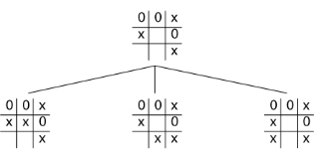
It is defined by: Initial state: It is an initial configuration of the game, that is, a state in which the game is located. For our example it would be:
Operators: They correspond to the legal plays that can be made in the game, in the case of the three in a row you can not check a box already marked before.

Slide 11


Terminal Condition: Determines when the game is over, in our example the game ends when a player marks three boxes in a row equal, either horizontally, vertically or diagonally, or all the boxes are marked (tie).
Utility Function: Gives a numerical value to a final configuration of a game. In a game where you can win, lose, or draw, the values can be 1, 0, or -1.

Slide 12
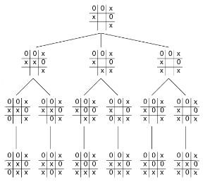

The algorithm first generates a complete solution tree from a given node. let's look at the following example:
For each end node, we look for the utility function of these. In our example we will use a 0 for the games that end in a draw, a 1 for those that the AI wins and a -1 for those that the human player wins.

Slide 13
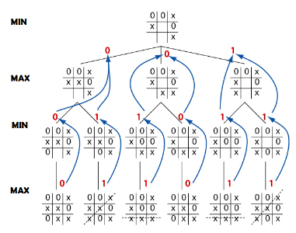
And what the Minimax algorithm will do when it goes back, will be to communicate to the upper recursive call which is the best leaf node reached so far. Each recursive call has to know who has to play, to analyze if the movement made belongs to the AI or to the other player, since when it is the turn of the AI we are interested in MAXIMIZING the result, and when it is the turn of the rival MINIMIZE its result.
In the end the algorithm will return the play that the machine must make to maximize its possibilities and block the possibilities of the opponent.

